Slide 1
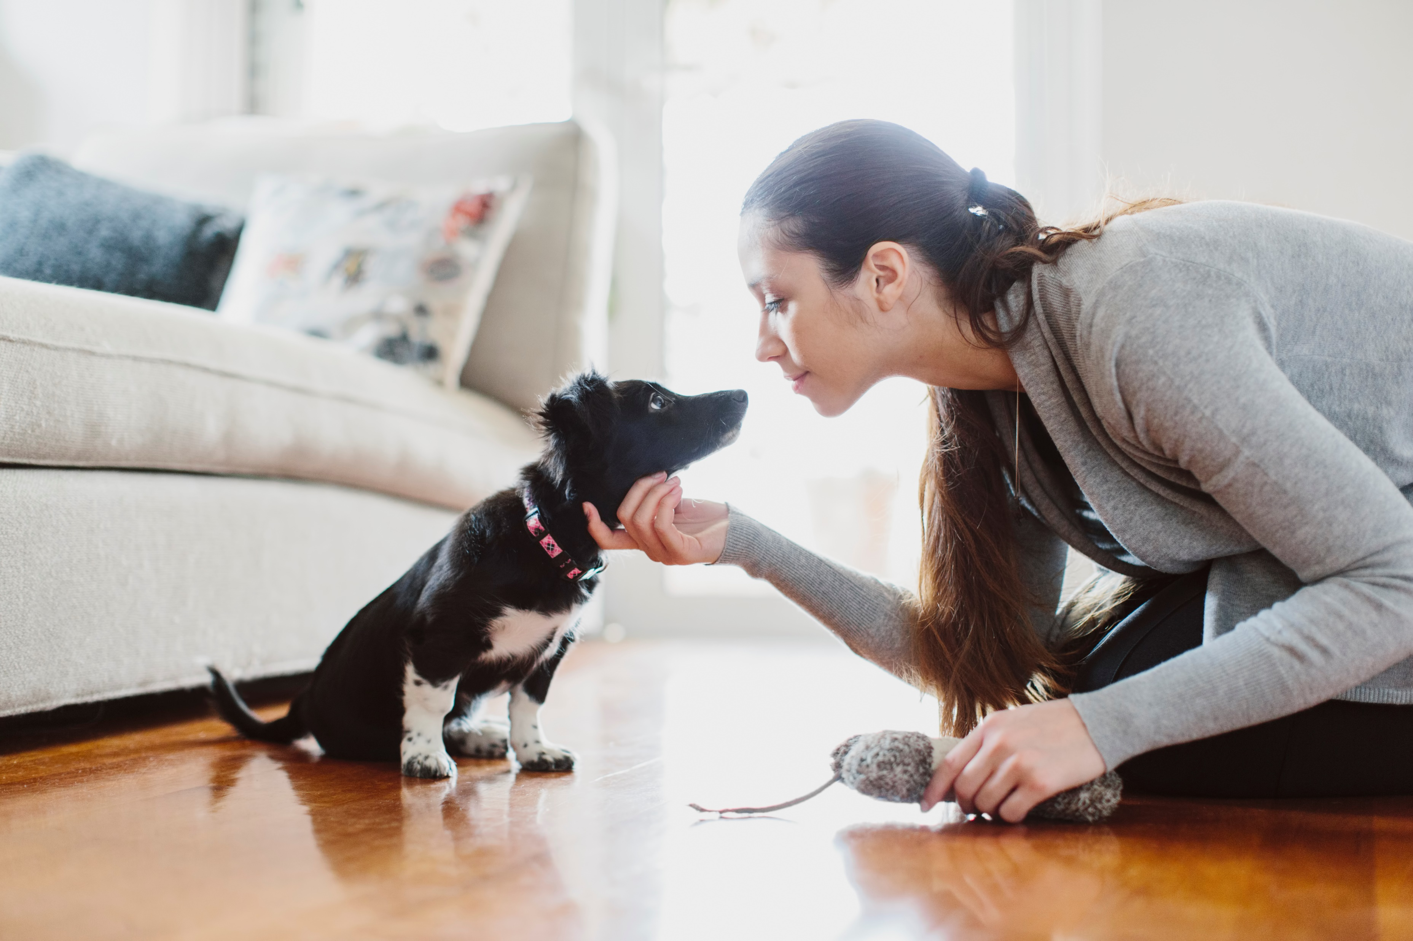
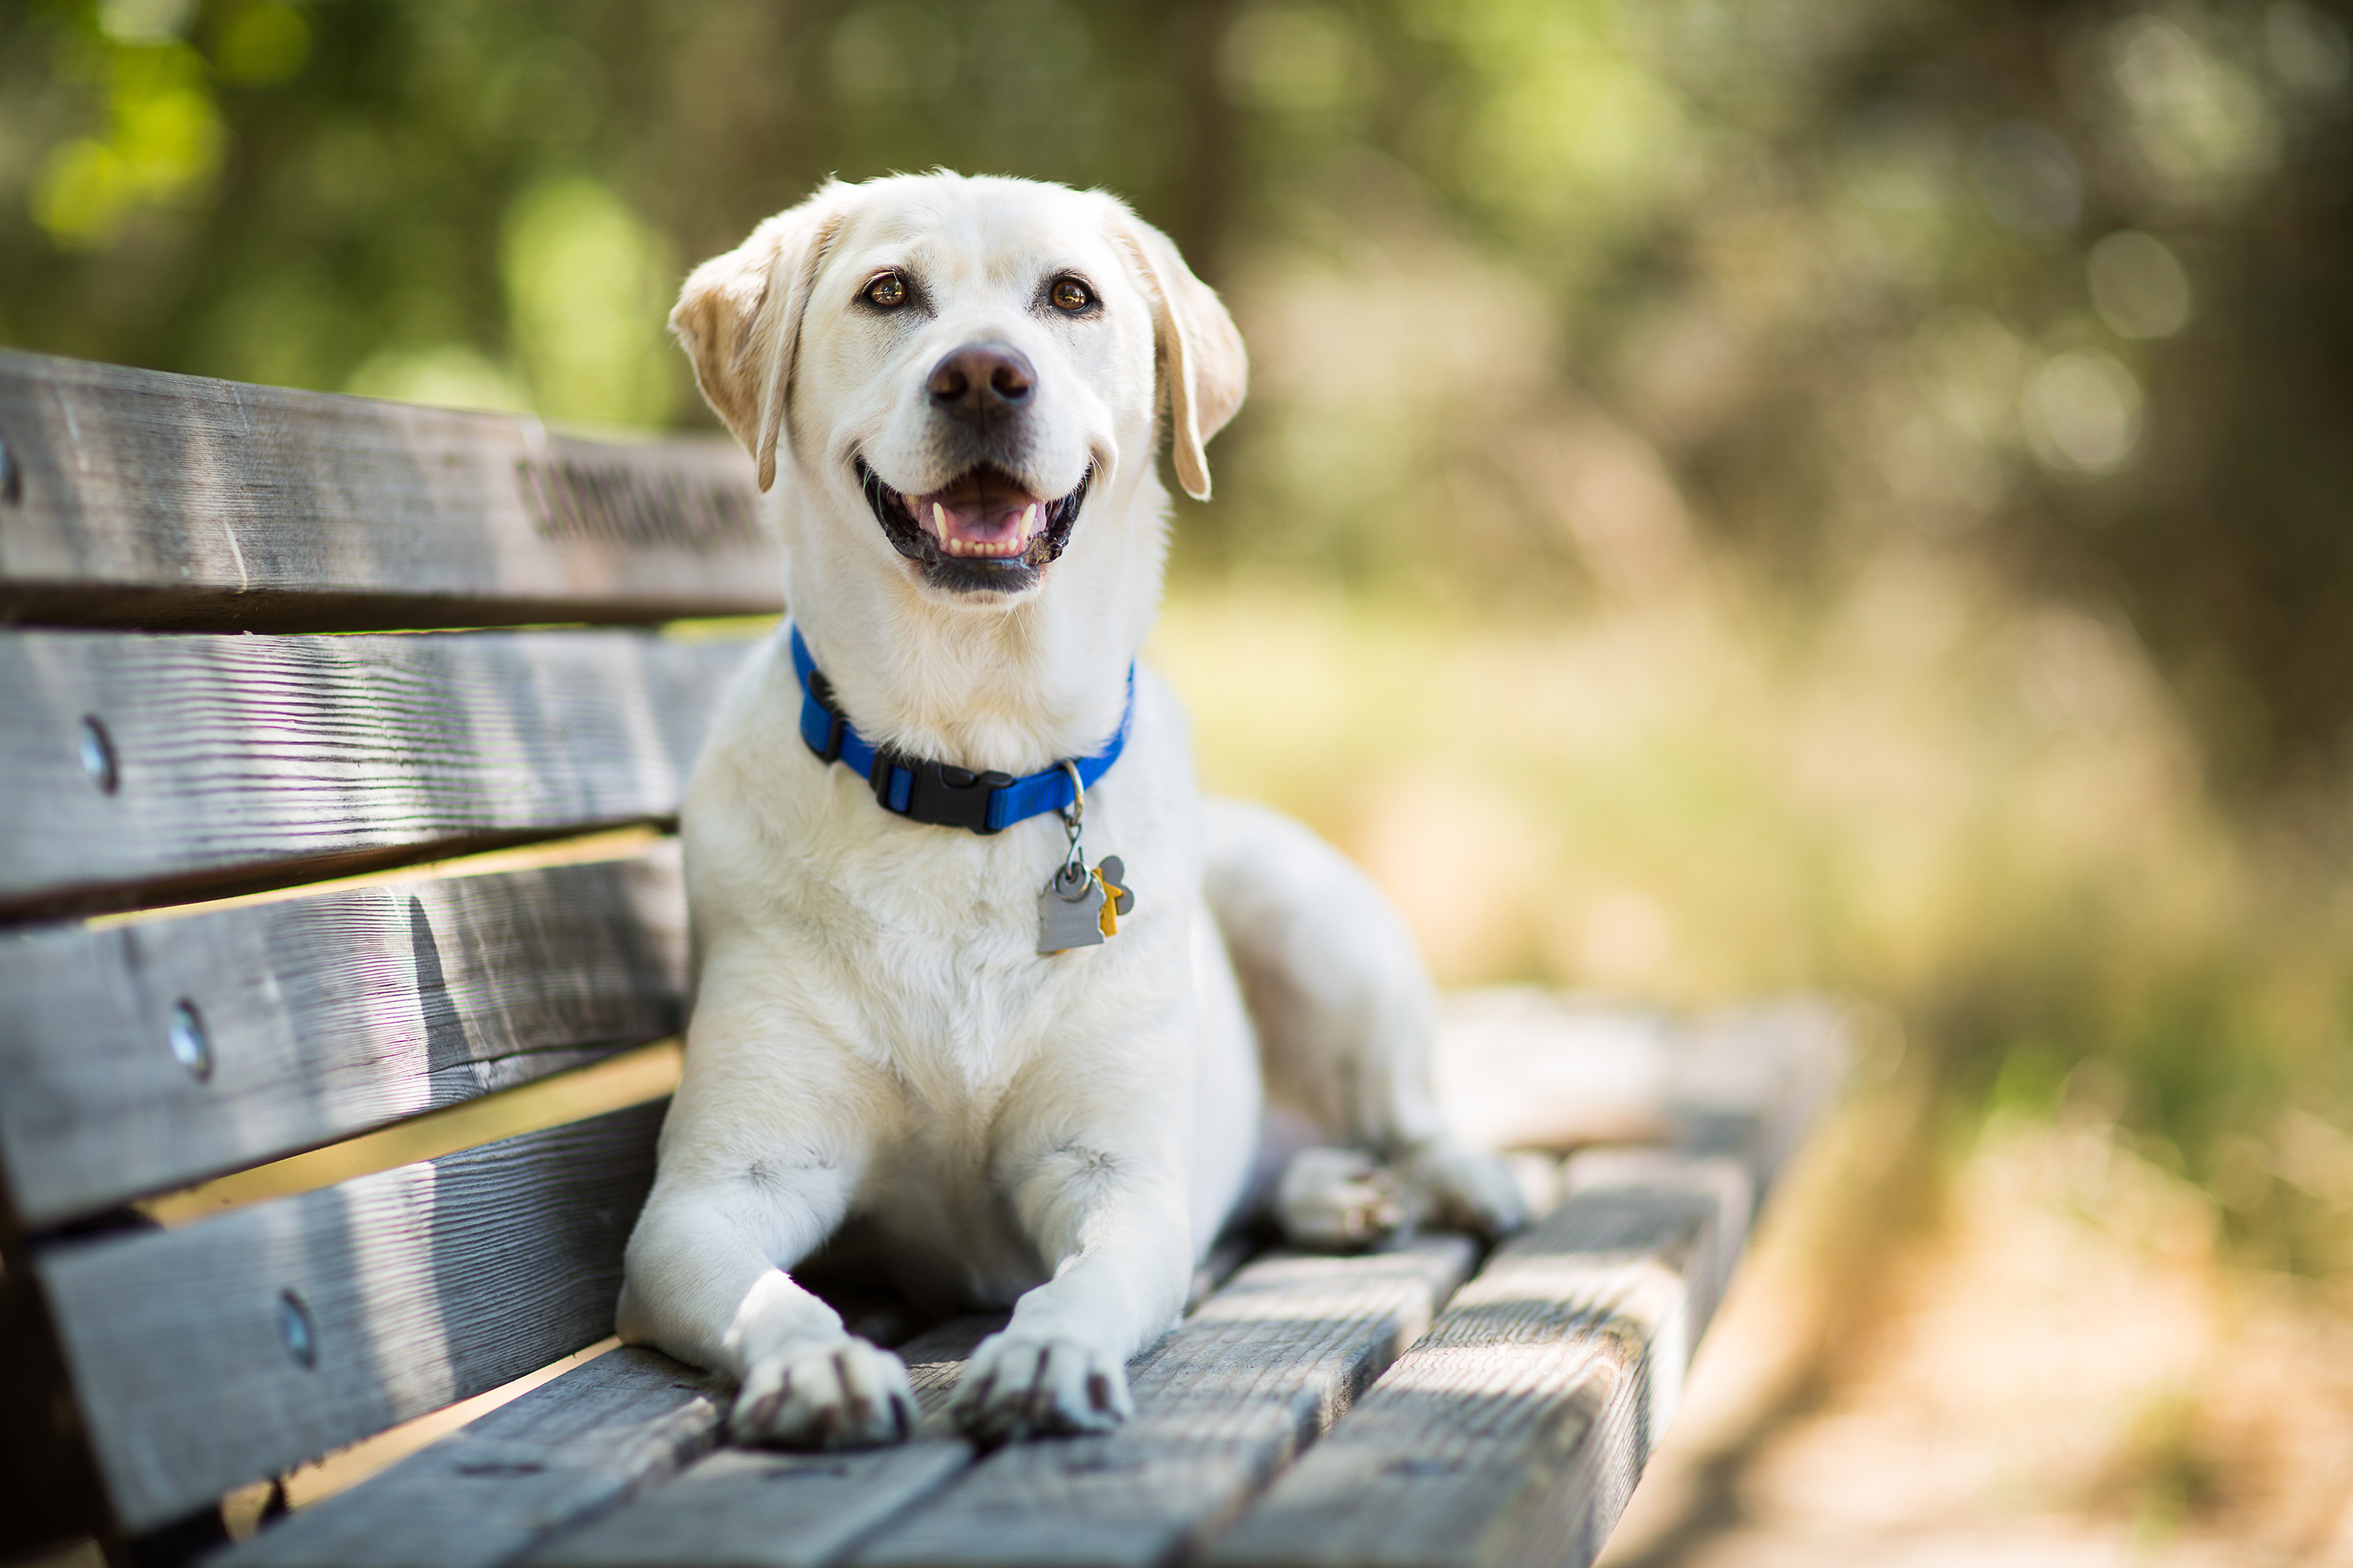
HomeWoof “It puts the paws in the right place” By: Justin Borders & John Bunch
We all know that it can be hard to act appropriately and behave the way you want them too. This is especially the case when they’re young. We want to develop an app that allows users to keep a (score) of how well their dog is behaving. We will do this by creating an app that lets you either add points for good behavior, subtract points for bad behavior, or take a half point for actions that need slight improvement.
https://github.com/ksu-is/Dog_Trainer

